Slide 1
Intermediate Competition
by MiMaCh System – Course of Intelligent Systems a.a. 2021/2022
Notes:
Hi Everyone! This is our presentetion for the intermediate competition and it is about our strategies and implementations for the Mean-Max game.

Slide 2
Contents
Mean-Max Game
The Game
The Goal
The Players
Different Leagues
Wood3
Wood2
Wood1
The Strategy
The Initial Approach
Bronze League Code
Conclusion
The results
Further Improvement
Bronze
The Environment
Notes:
Here is a brief list of the contents that we want to show in the presentation.
First there will be a description of the mean-max game
Then we will se the main diferences about the leagues that we reached
There we will discuss about our implementations and our approach
end at the end we will see the final result and classification and some possible improvements

Slide 3
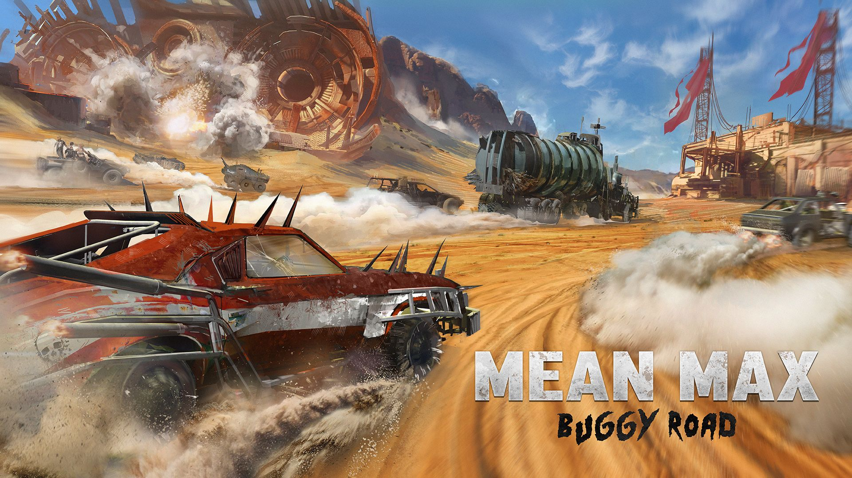
Mean-Max Game Bot Programming
Notes:
The Mean-Max Bot Programming is created by 4 CodinGamers. This is the first challenge crafted by the community as is written on the website. Maybe it is inspired by MAD MAX.

Slide 4
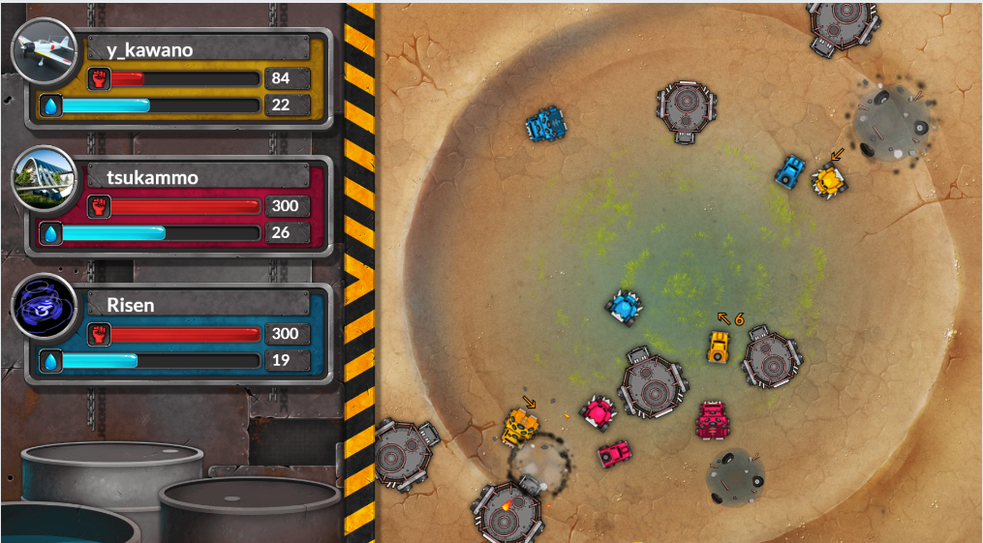
The Environment
Circular map of radius 6000 with 3 players.
Players move simultaneously.
Water Town is in (0,0) and has a radius of 3000.
Each player has 3 Looters (Reaper, Destroyer and Doof).
Tankers go to and from Water Town.
When a Tanker is destroyed by a Destroyer, a Wreck is created.

Slide 5
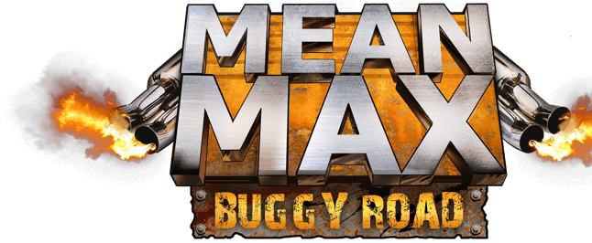
The Goal
Gather more water than your enemies.
Victory Conditions: have more water than your opponents at the end of the game.
The game is over once any player reaches 50 water or after 200 turns.

Slide 6
The Players
Looters
Others
Reaper: takes water from a wreck.
Destroyer: destroys tankers.
Doof: generates rage.
In Yellow controlled by our code.
In Blue and Magenta our enemies.
Tankers: autonomous movement.
Wrecks: a wreck appears after a tenker is destroyed.

Slide 7
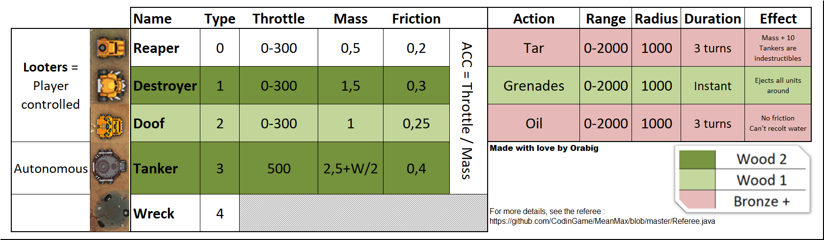
Summary

Slide 8


Different Leagues
Wood3
3 Players (Reapers) in the map
Wood2
3 Players and 3 Destroyers in the map
Wood1
3 Players, 3 Destroyers and 3 Doofs.
Bronze
All the looters can use a SKILL
Wrecks of water
At each turn the player must either:
Go to a position (X, Y)
WAIT
Tankers and Wrecks
At each turn our player and our destroyer move or wait
Tankers and Wrecks.
Now destroyers can use a SKILL on (X,Y)
At each turn looters can move or wait
At each turn looters can move, wait or use skill
2 new skills
Tar pool (Reaper skill)
Oil pool (Doof skill)
Notes:
REMARK: the skills have effects in a radius of 1000. The destroyers can use NITRO GRENATE to put away the entity affected. The Tar pool is a skill used by the reapers. it is a pool of mud that locks other entities. the oil pool is a pool of oil that is used by the doofs. the entity on this pool has like 0 friction so they slide away.

Slide 9
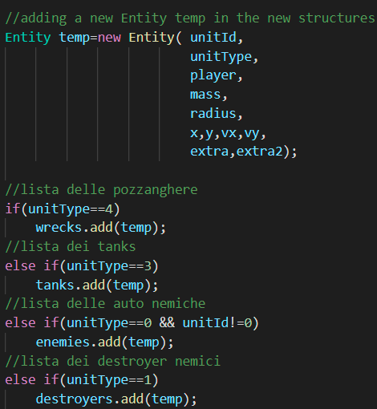
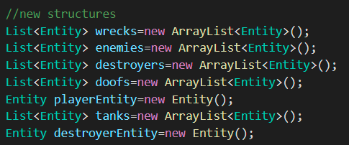
The Initial Approach
We created a new class Entity
We focused on the goal
Our player has to reach more wrecks as possible
Notes:
We decided to map the entities of the map in a new class Entity. In this way we can have Entity List of the same types (like a list of wrecks) and we can easly refers to our player or our enemies. And also, we focused on the goal of the game which is to take more water then the opponents. So, it is easy to understand that the best choice is intuitively to reach more wrecks as possible.

Slide 10
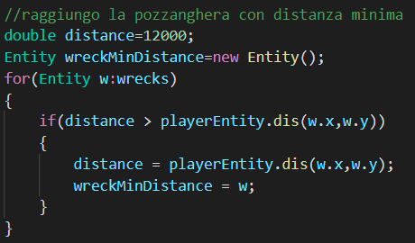
The Initial Approach - Wood3
We calculated the closer wreck from our Reaper

Slide 11
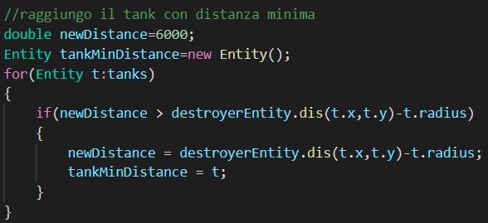
The Initial Approach - Wood2
We defined Destroyer’s behaviour
We calculated the closer Tanker from our Destroyer

Slide 12
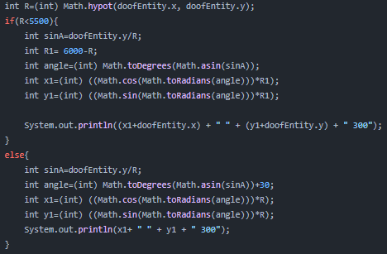
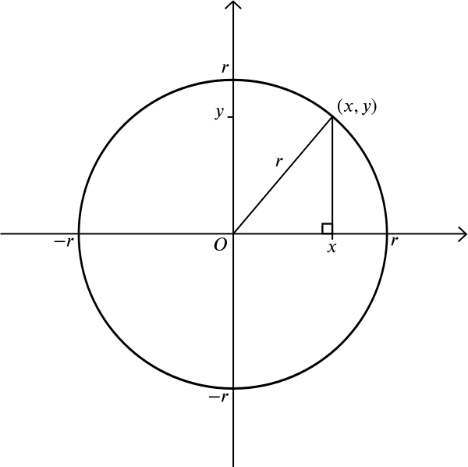
The Initial Approach - Wood1
We defined Doof’s behaviour
We calculated a circular motion using trigonometry formulas

Slide 13
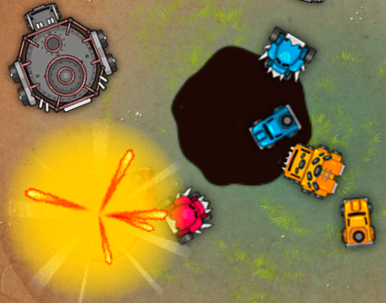
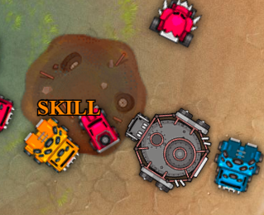
Bronze League Code - I
In Bronze League two new skills are added:
Doof skill: an oil pool that lasts 3 turns in the game and affected in a radius of 1000
Reaper skill: a tar pool that lasts 3 turns in the game and affected in a radius of 1000

Slide 14
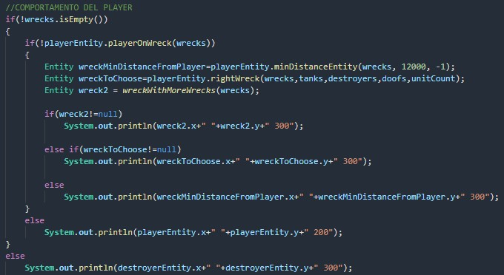
Bronze League Code - II
Now our player does not just reach the nearest wreck:
It first checks if there are more overlapping wrecks, giving them priority;
otherwise looks for the closest and freest one, that is the one with as few entities as possible nearby.
Otherwise it will simply go to the nearest one.

Slide 15
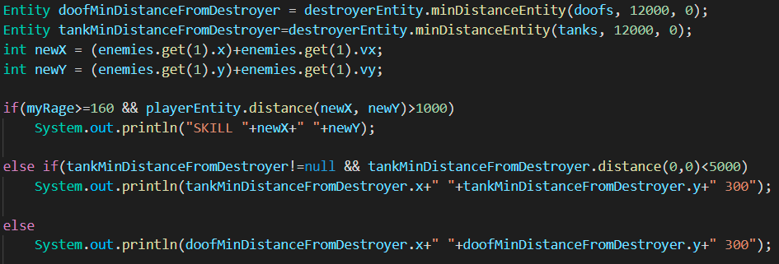
Bronze League Code - III
Our Destroyer tries to reach the nearest Tanker to eliminate it.
Also, when the rage is grater then a specific value, it uses its skill (Nitro Grenade) to push vehicles away.
In case there are no Tankers it simply goes near the closest enemy Doof.

Slide 16
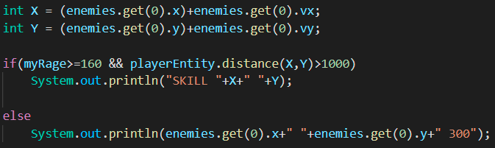
Bronze League Code - IV
In the previous league, our doof was just trying to move as much as possible in a circular way to accumulate rage.
Now it uses its skill (the Oil Pool) if the rage is greater than a specific value and our player (Reaper) is far enough.
Otherwise it will chase the opposing Reaper to annoy him so that it has difficulty reaching the wrecks.

Slide 17
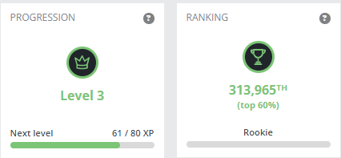
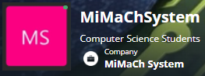
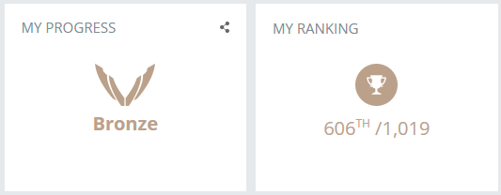
Conclusion - Reached Result
Notes:
We didn’t reach the best possible result. but we reached the bronze league in few days.

Slide 18
Conclusion - Possible Improvements
Strengths
Weaknesses
Our Destroyer and our Doof do not constitute a barrier to our Reaper
They target one of the enemies (also with their skills)
Managing the collision of our Reaper
Target both the enemies at the same time
Notes:
at the moment the behaviour of the destroyers and and doofs are not so bad because we reach more rage then the other doofs. also they do not cause difficulties to our Reaper but they target a specific enemy. so, about this point we can improve our implementation by target both the enemies with Grenade and Oil Pools and not just one affected by grenades and the other by oil pools.
But the main weakness or our code is the collision of the player. we do not manage it and it is a problem because when it want to reach a wreck but its path is full of enemies or other entities different from wrecks, it will always stay locked without choosing a new path or a new wreck to reach.

Slide 19
Resources
Bot programming, Mean-max
Codingame.com
MiMaCh System – Profile
Github - Mean-Max - Referee.java
Github - MiMaCh System Proj - Intermediate Competition
Notes:
Here there some useful link, out git repository and other utilities about codingame and mean-max bot

Slide 20
Thanks for your attention
MiMaCh System
Canonaco Martina [231874]
Morello Michele [223953]
Passarelli Chiara [223971]

